Slide 1


Basaveshwar Engineering College
Bagalkote-587102
A
Title Presentation
On
AI WEAPONS
Submitted by
Mr.Abhishek Uday Bhilawade,(2BA24MC001)
Dept of MCA,BEC,Bagalkote
Supervisor
Prof.Sangamesh M Magi
Assistant.Professor,Dept of MCA,BEC,Bagalkote

Slide 2
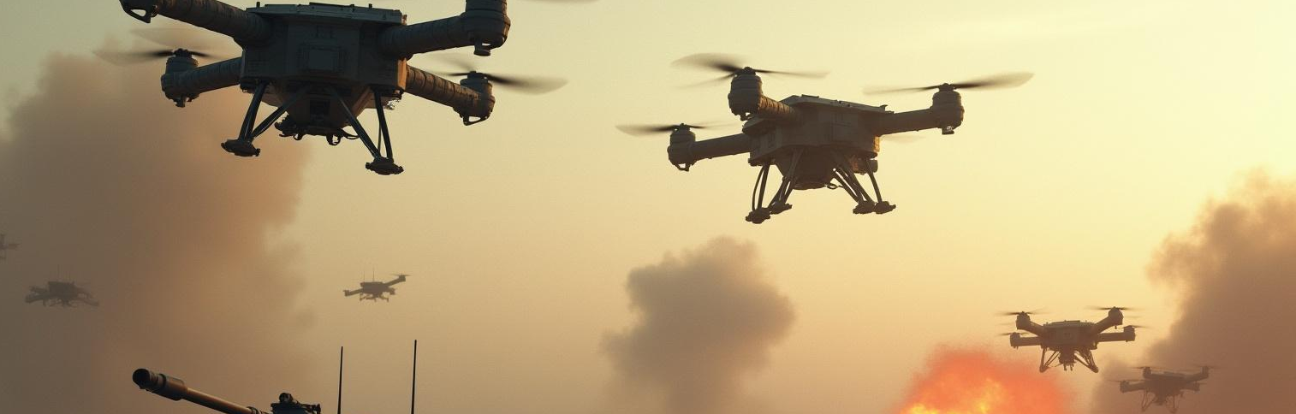
AI Weapons: An Overview
01/20
Understanding the implications and future of AI in military applications
USN : 2BA24MC001
14/08/2025

Slide 3

Introduction
02/20
This presentation delves into the realm of AI weapons, exploring their definitions, types, and current military applications. It emphasizes the ethical considerations surrounding their use and projects future perspectives within the realm of artificial intelligence in warfare.
USN : 2BA24MC001
14/08/2025

Slide 4
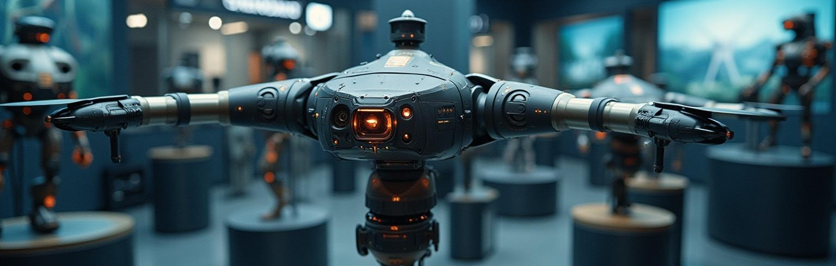
01
AI Weapons Overview
03/20
USN : 2BA24MC001
14/08/2025

Slide 5
Definition of AI Weapons
04/20
AI weapons refer to systems that utilize artificial intelligence to execute tasks typically performed by humans. This includes autonomous decision-making in combat scenarios, enhancing targeting accuracy, and improving overall operational efficiency within military frameworks.
USN : 2BA24MC001
14/08/2025

Slide 6
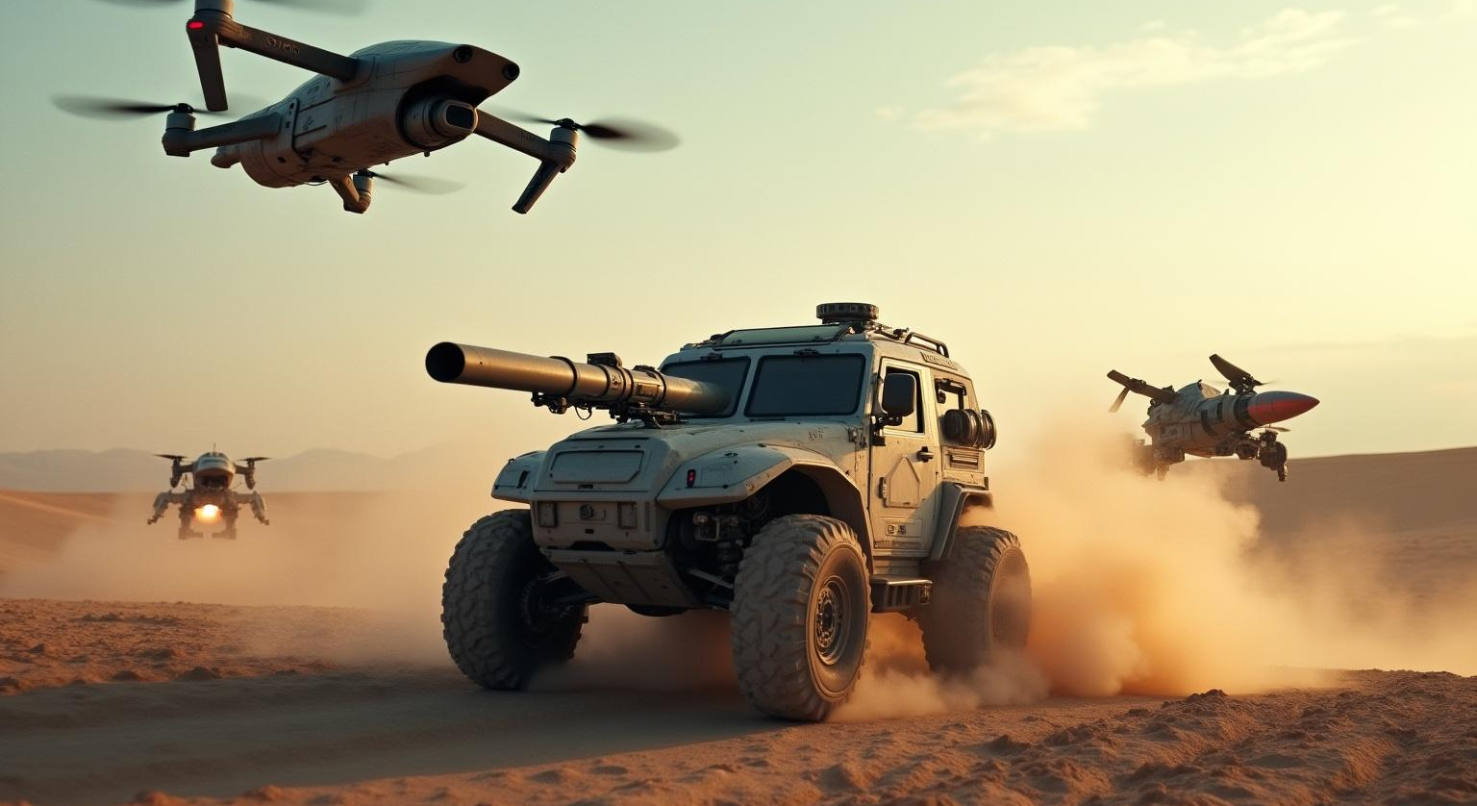
Types of AI Weapons
05/20
AI weapons can be categorized into various types, including autonomous drones, robotic ground vehicles, and missile systems equipped with smart targeting capabilities. Each category reflects a unique capability, emphasizing diverse applications in modern warfare.
USN : 2BA24MC001
14/08/2025

Slide 7
Current Usage in Military
06/20
Military forces worldwide are increasingly integrating AI weapons into their arsenals. These systems are designed to enhance mission effectiveness, reduce human risk, and provide strategic advantages in combat situations. Their current usage signifies a pivotal shift in combat strategies and defense operations.
USN : 2BA24MC001
14/08/2025

Slide 8
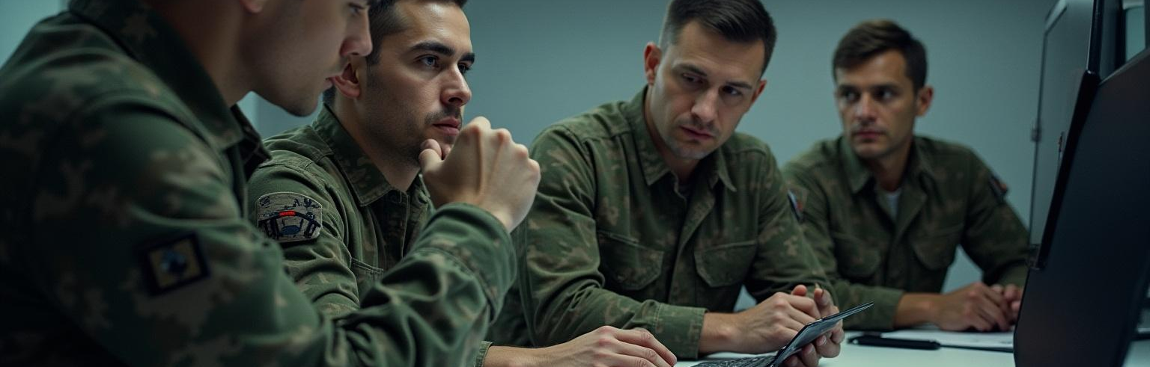
02
Ethical Considerations
07/20
USN : 2BA24MC001
14/08/2025

Slide 9
Moral Implications of AI in Warfare
08/20
The deployment of AI in warfare raises significant moral questions, primarily regarding the potential for loss of human oversight and the ethical ramifications of autonomous decisions in life-and-death situations. These concerns necessitate thorough scrutiny and debate within the military and humanitarian communities.
USN : 2BA24MC001
14/08/2025

Slide 10
Accountability and Responsibility
09/20
As AI systems assume greater roles in military operations, issues surrounding accountability arise. It is essential to delineate responsibility for actions taken by autonomous systems, particularly in instances of unintended consequences or failure, to ensure adherence to ethical standards and international humanitarian laws.
USN : 2BA24MC001
14/08/2025

Slide 11
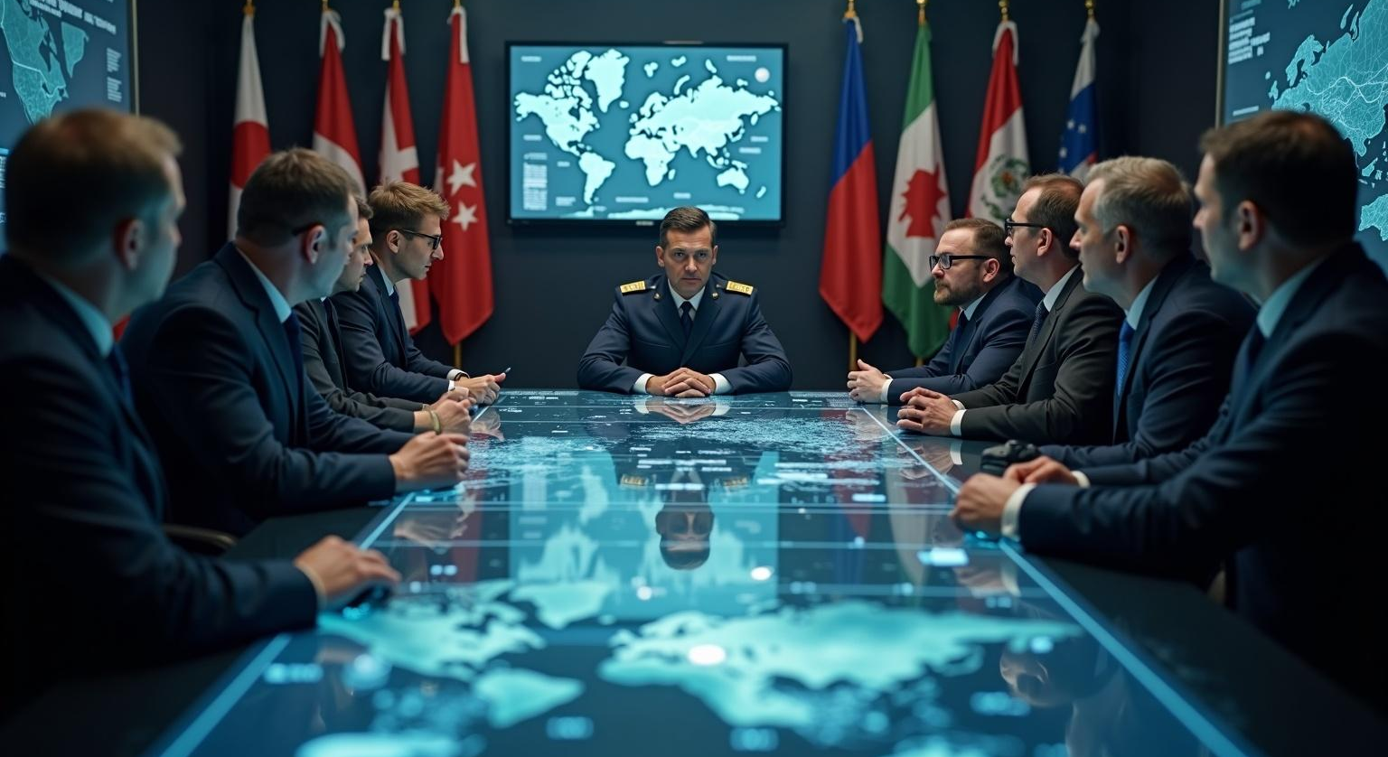
Compliance with International Laws
10/20
The implementation of AI weapons must adhere to established international laws and treaties governing warfare. This includes respecting humanitarian principles and ensuring that AI systems comply with regulations designed to protect civilian lives and property. Ongoing dialogue among nations is crucial to frame these legal standards appropriately.
USN : 2BA24MC001
14/08/2025

Slide 12

03
Technological Advancements
11/20
USN : 2BA24MC001
14/08/2025

Slide 13
AI Algorithms in Weaponry
12/20
Advanced AI algorithms play a critical role in the development of modern weaponry, enabling improved targeting and operational efficiencies. These algorithms analyze vast amounts of battlefield data, enhancing decision-making processes and ensuring precise engagement capabilities for military systems.
USN : 2BA24MC001
14/08/2025

Slide 14
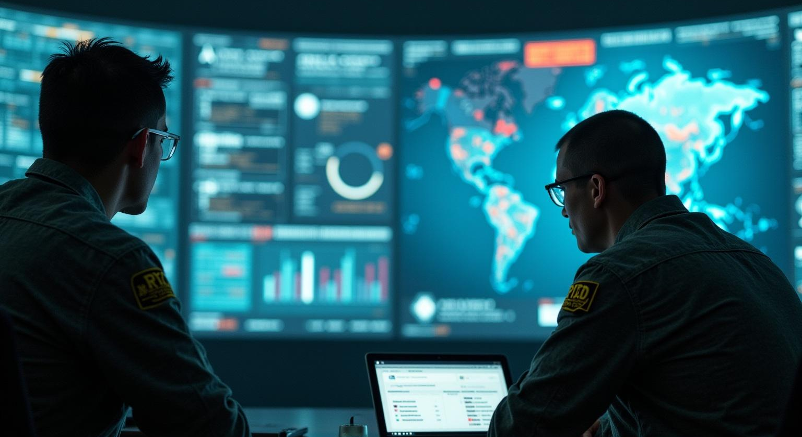
Data Analysis and Decision-Making
13/20
Data analysis facilitated by AI is transforming military decision-making processes. By processing real-time information from various sources, AI systems can identify patterns and trends, allowing military leaders to make well-informed decisions quickly and effectively in dynamic combat environments.
USN : 2BA24MC001
14/08/2025

Slide 15
Automation and Autonomous Systems
14/20
The rise of automation and autonomous systems in military applications marks a significant technological advancement. These systems are capable of operating independently, executing missions without direct human control, and reducing human risk in combat situations, thereby redefining the future of warfare.
USN : 2BA24MC001
14/08/2025

Slide 16

04
Future Perspectives
15/20
USN : 2BA24MC001
14/08/2025

Slide 17
Trends in AI Military Applications
16/20
Future trends indicate an increasing integration of AI in military applications. As technology advances, we can expect more sophisticated AI systems capable of multitasking in complex environments, influencing tactics and strategies utilized by armed forces worldwide.
USN : 2BA24MC001
14/08/2025

Slide 18
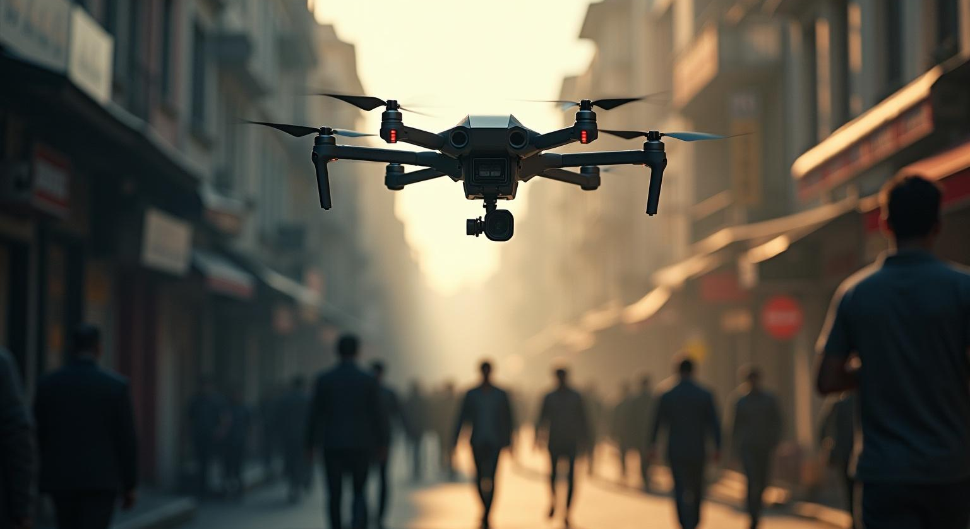
Potential Risks and Challenges
17/20
While AI weapons offer numerous benefits, they also present potential risks and challenges, including the likelihood of unintended engagements and ethical dilemmas over control. Addressing these risks is essential to ensure responsible development and deployment of AI technologies in military contexts.
USN : 2BA24MC001
14/08/2025

Slide 19
Policy Recommendations for Safe Usage
18/20
To harness the benefits of AI weapons effectively while mitigating risks, comprehensive policy frameworks are needed. Recommendations include establishing international agreements on AI weapon usage, fostering transparency in AI development, and advocating for ethical guidelines to govern autonomous military systems.
USN : 2BA24MC001
14/08/2025

Slide 20
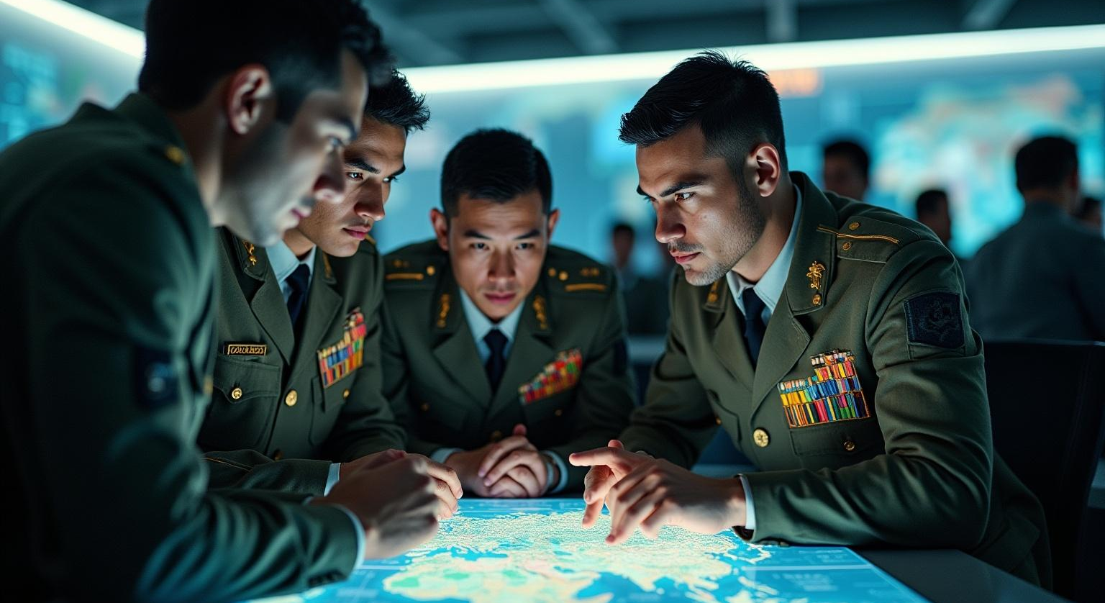
Conclusions
19/20
The integration of AI in military applications presents opportunities and challenges that must be carefully navigated. Upholding ethical standards, ensuring compliance with international laws, and prioritizing responsible development are essential in shaping the future landscape of warfare.
USN : 2BA24MC001
14/08/2025

Slide 21
20/20
THANK
YOU ……..
USN : 2B24MC001
14/08/2025

